Slide 1

Understanding Data Structures in R: The Foundation of Data Science

Slide 2
Data Structures
Data structures are used to store and organize values.
R provides many built-in data structures. Each is used to handle data in different ways:
Vectors
Lists
Matrices
Arrays
Data Frames
We will explore all of them in detail later, but for now, here's a quick introduction to each one.

Slide 3
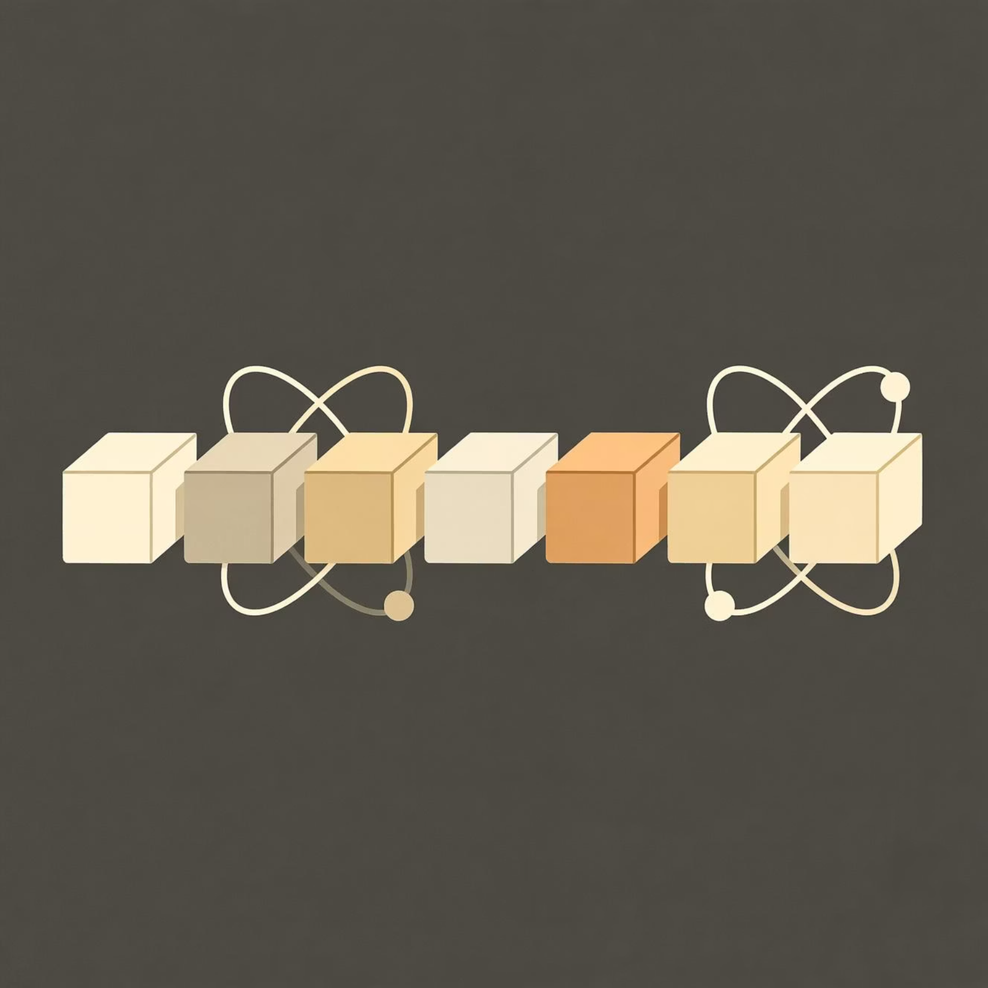
Vectors
A vector is the most basic data structure in R. It contains a list of items of the same type.
A vector is simply a list of items that are of the same type.
To combine the list of items to a vector, use the c() function and separate the items by a comma.

Slide 4
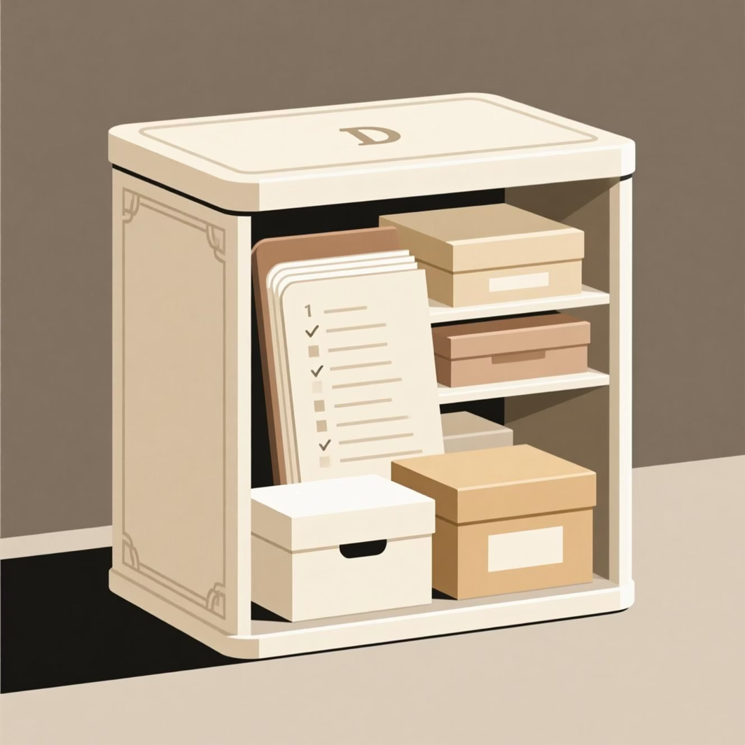
List
A list can hold different types of data in one structure. You can combine numbers, strings, vectors, and even other lists.
A list in R can contain many different data types inside it. A list is a collection of data which is ordered and changeable.
To create a list, use the list() function.
This_list <- list("apple", "banana", 50, 100)

Slide 5
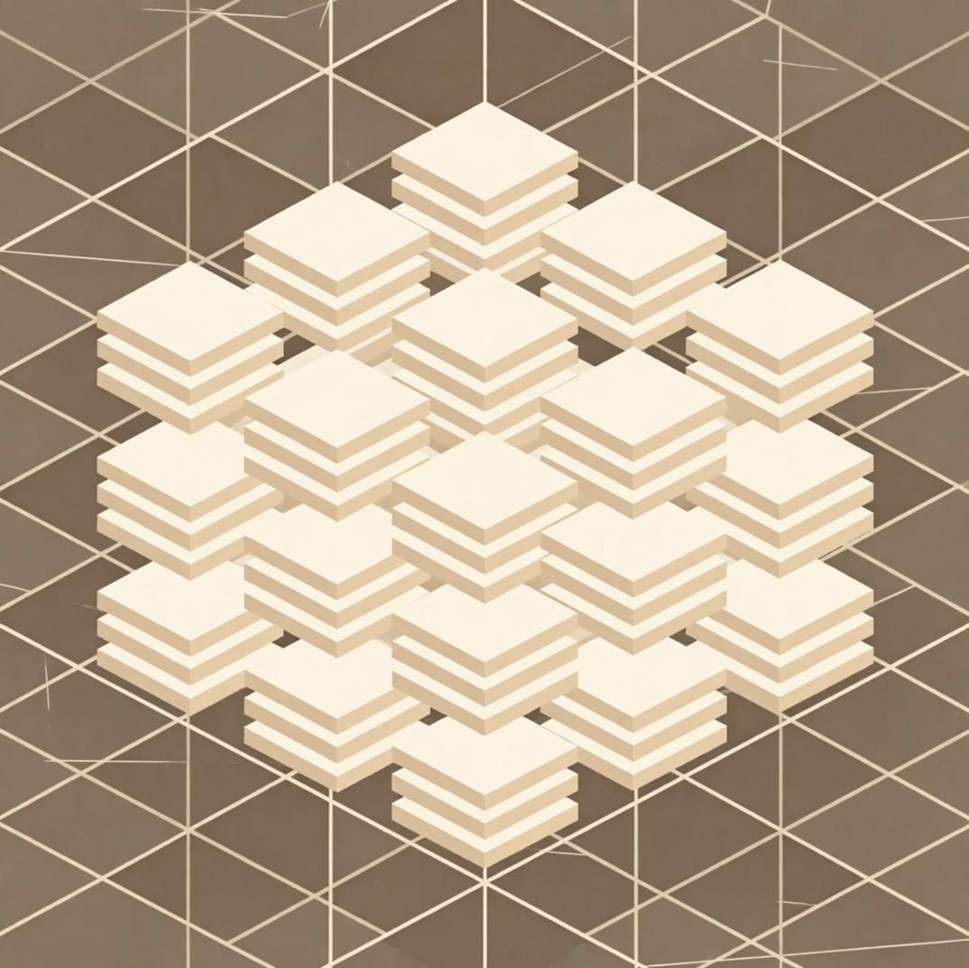
Matrices
A matrix is a 2D data structure where all elements are of the same type. It is like a table with rows and columns.
A matrix is a two-dimensional data set with columns and rows.
A column is a vertical representation of data, while a row is a horizontal representation of data.
A matrix can be created with the matrix() function. Specify the nrow and ncol parameters to get the amount of rows and columns:
# Create a matrix thismatrix <- matrix(c(1,2,3,4,5,6), nrow = 3, ncol = 2) # Print the matrix thismatrix

Slide 6
Arrays
An array is like a matrix but can have more than two dimensions. It stores elements of the same type in multiple dimensions.
Compared to matrices, arrays can have more than two dimensions.
We can use the array() function to create an array, and the dim parameter to specify the dimensions.
Example
# An array with one dimension with values ranging from 1 to 24
thisarray <- c(1:24)
thisarray
# An array with more than one dimension
multiarray <- array(thisarray, dim = c(4, 3, 2))
multiarray

Slide 7
Data Frames
Data Frames are data displayed in a format as a table.
Data Frames can have different types of data inside it. While the first column can be character, the second and third can be numeric or logical. However, each column should have the same type of data.
Use the data.frame() function to create a data frame.
Example
# Create a data frame
Data_Frame <- data.frame (
Training = c("Strength", "Stamina", "Other"),
Pulse = c(100, 150, 120),
Duration = c(60, 30, 45)
)
# Print the data frame
Data_Frame

